Slide 1
Urry Group Weekly Update
Thursday, July 14th

Slide 2
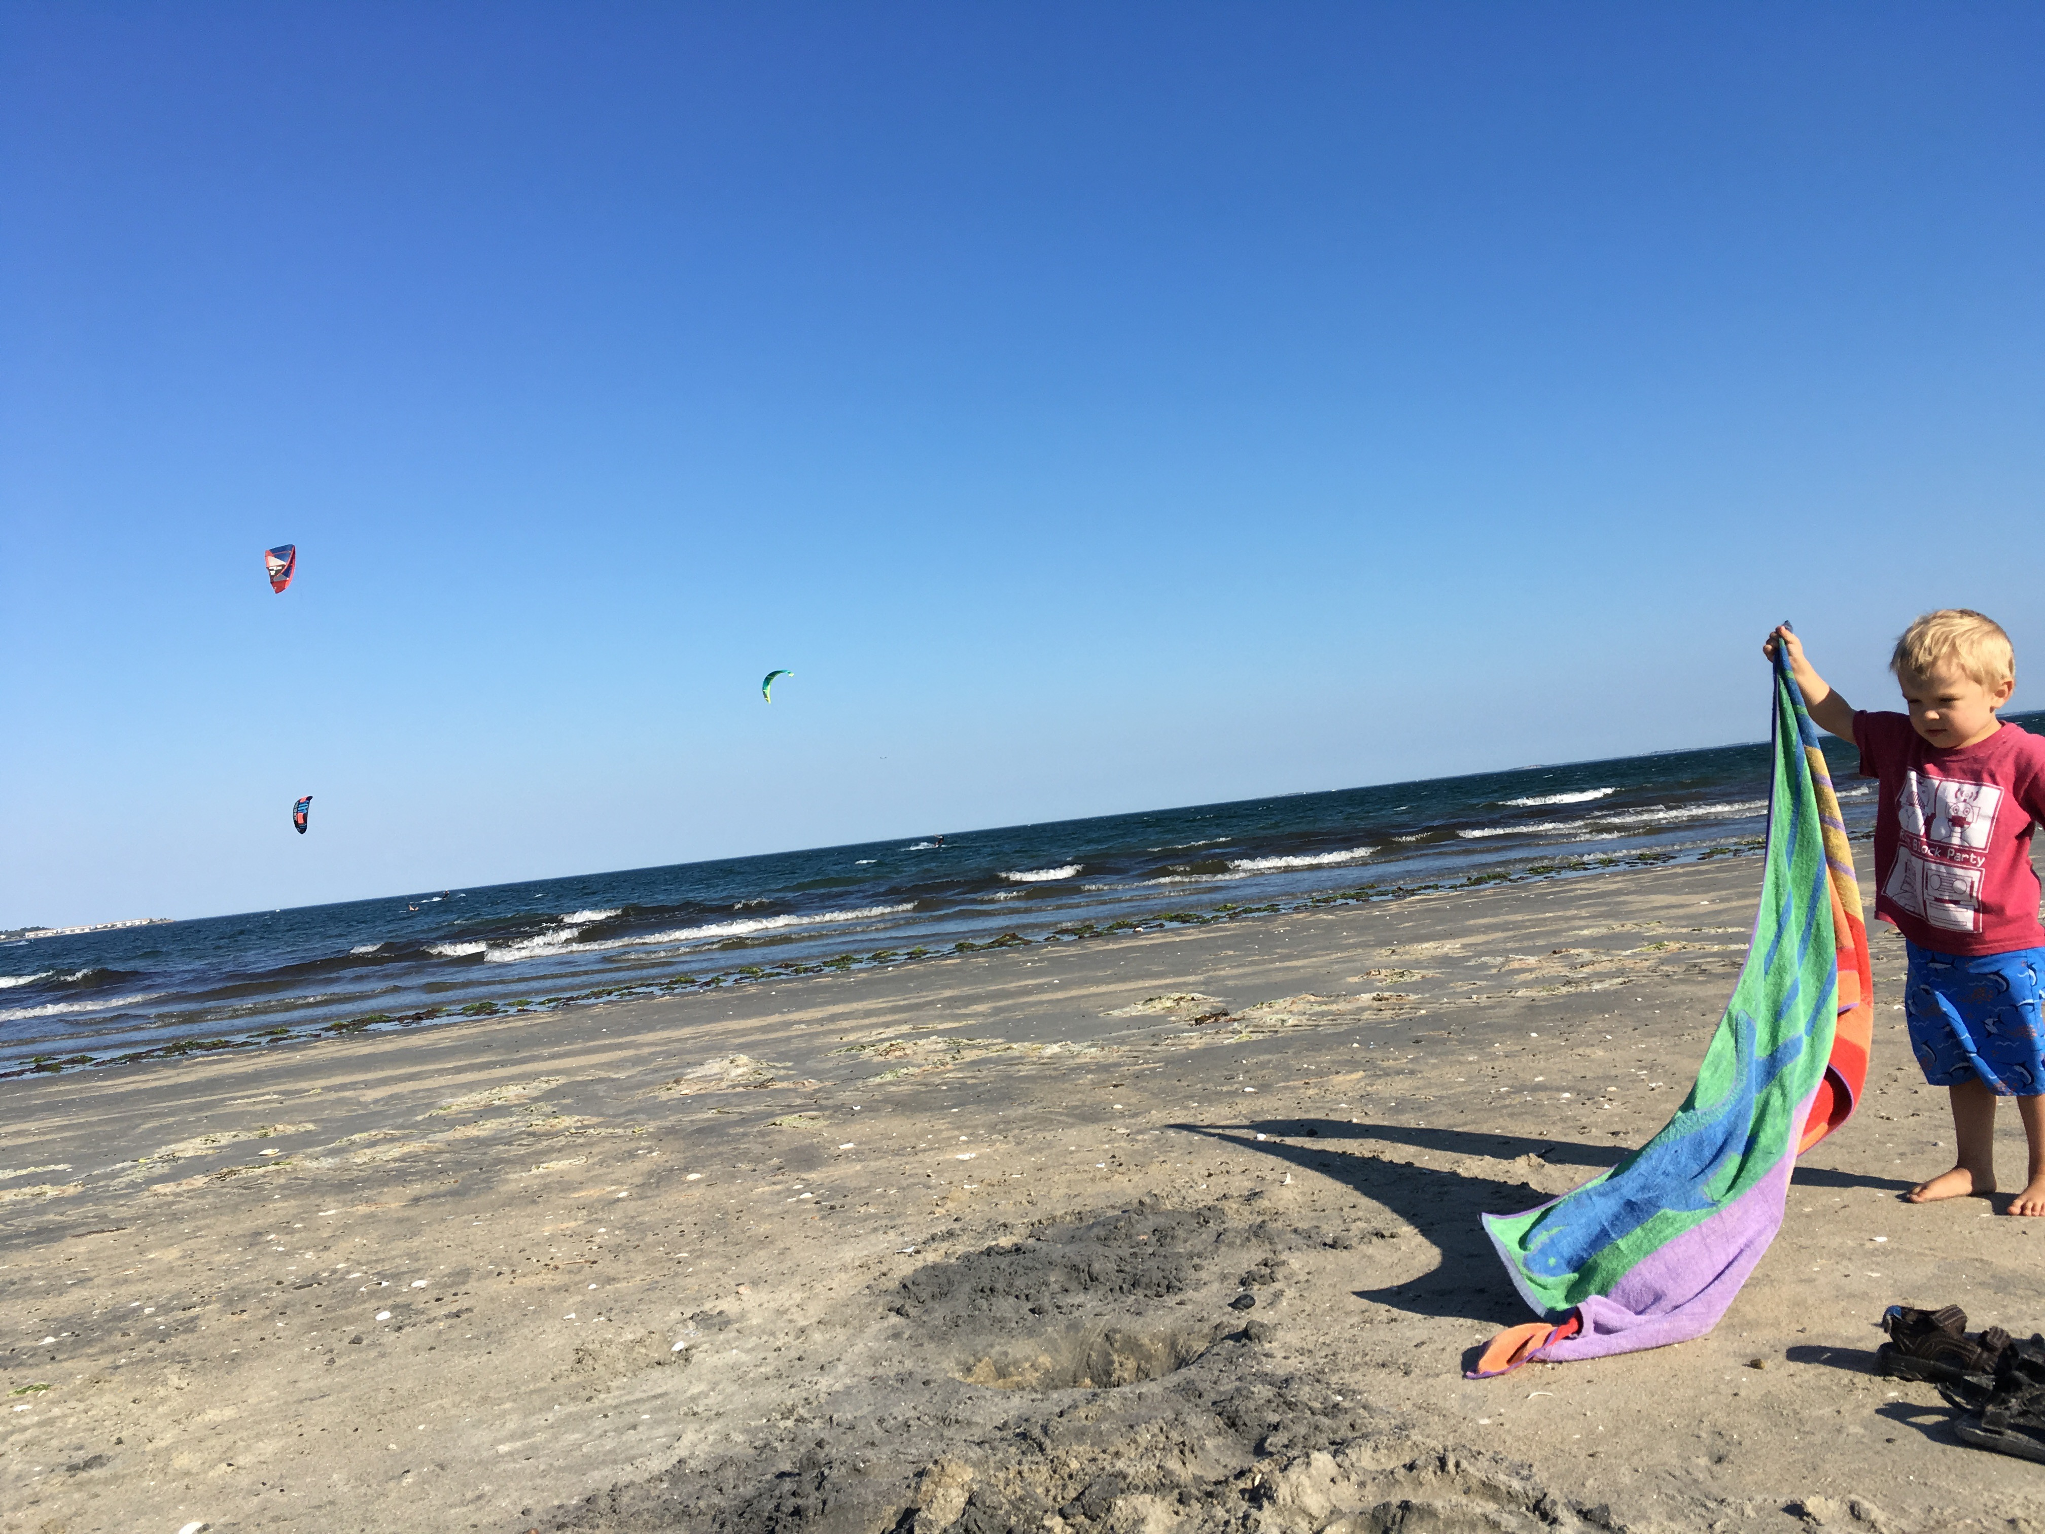

Slide 3
HST Search - PEAS
63 of the 1346 ‘new’ BOSS peas are in HST imaging + 11 of the 24 original peas not in BOSS search result
Trying to get actual data now….
Recent proposals:
Lyman alpha escape in Green Pea galaxies (give peas a chance)
Green Pea Galaxies: Extreme, Optically-Thin Starbursts?
UV Spectroscopy of Lyman Break Galaxy Analogs: A Local Window on the Early Universe
Origin of double peaks in Lyman-alpha spectra: diffuse halos or Lyman continuum leakage?
Unveiling the Dark Baryons II: the First Sample of OVI Emission Imaging
UV Snapshot of Low-redshift Massive Star-forming Galaxies: Searching for the Analogs of High-redshift Clumpy Galaxies

Slide 4
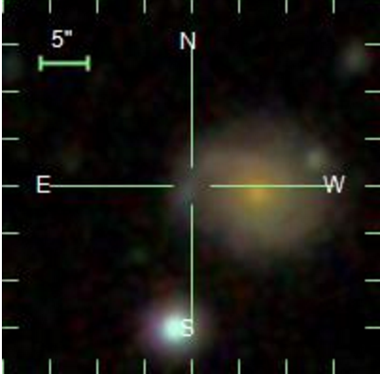
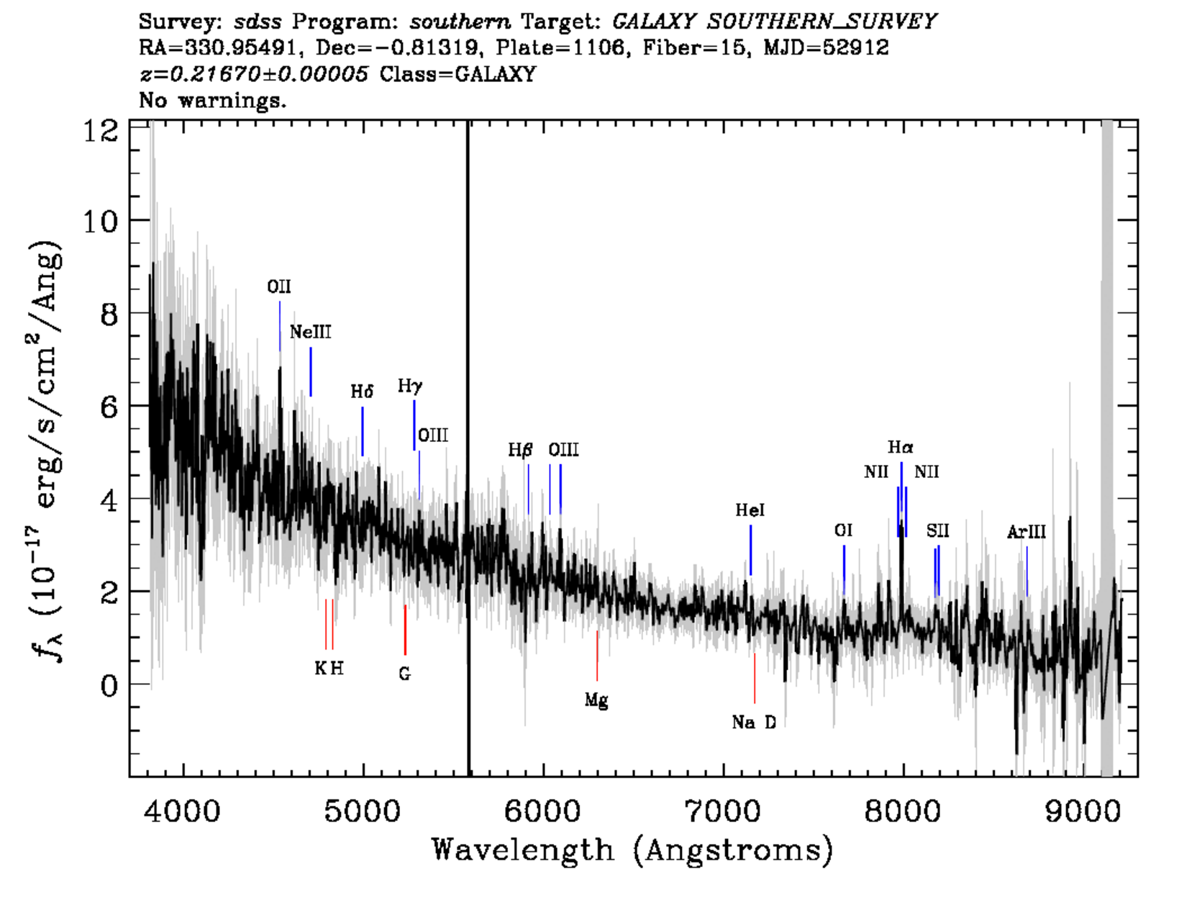
Cleaning DR 12 Pea Sample
Select ‘clean’ photometry flag (huge leap forward)
Issues still remaining: a couple in another galaxy,
a few with spectra missing OIII lines

Slide 5
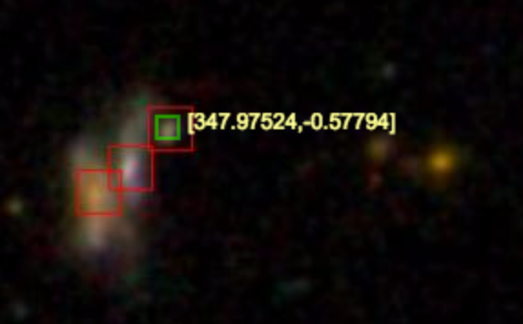
Cleaning DR 12 Pea Sample
Original Sample required A/N > 3
Looking at these images
I see lots with neighbors
Peas Search in DR12
DR12 (color & size): 4155
DR12 Portsmouth Group: 2203
DR12 Portsmouth Group SF: 1592
DR12 Portsmouth Group SF & clean phot: 1454
DR12 A/N gt 3 in all lines: 739

Slide 6
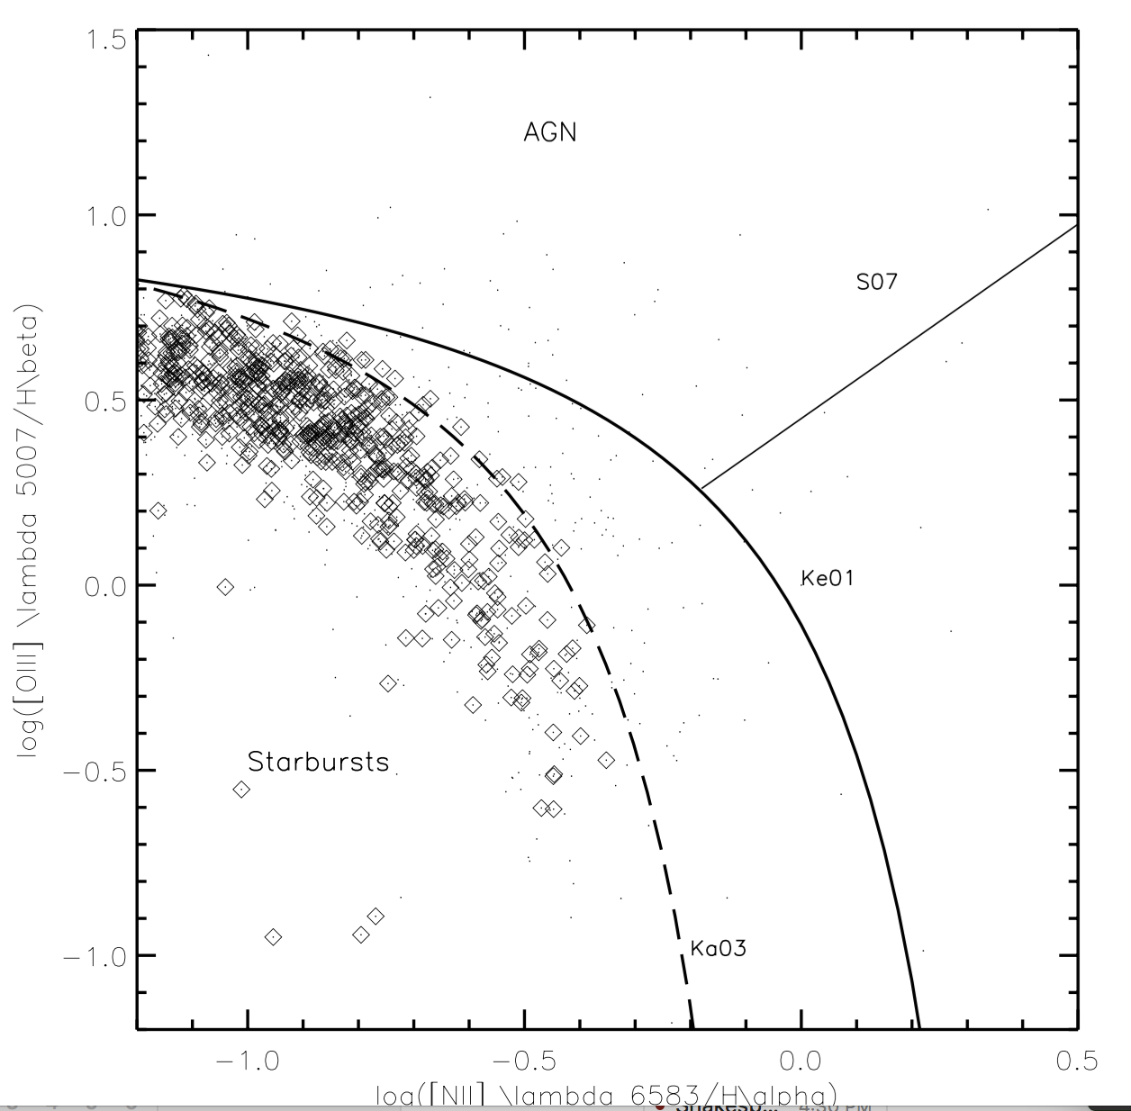

Slide 7
Neighbors w/out spec/photoz

Slide 8
Next (3) weeks
Finalize ‘new’ DR 12 Peas
Search for neighbors in DR 12 catalog (no z, photoz required)
Download HST images where available for comparison. Create HST gallery…

Slide 10
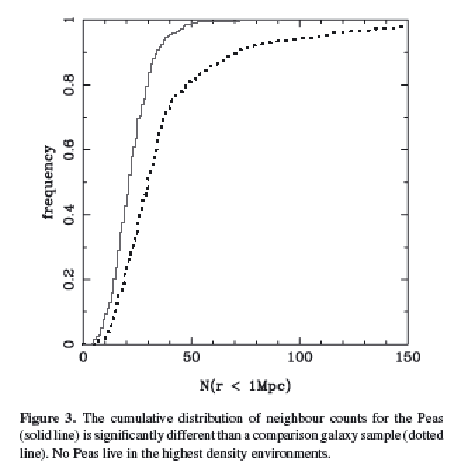
Cardamone et al. 2009
Projected density around Peas vs. sample matched in luminosity and redshift
Looked within projected 1Mpc, and imag > -20.5
Notes:
Projected density around Peas vs. sample matched in luminosity and redshift
Looked within 1Mpc, and imag > -20.5
Peas lie in lower density regions than typical gal at same i-band luminosity
KS test 8 sigma
Median environmental density less than 2/3rds normal galaxies

Slide 11
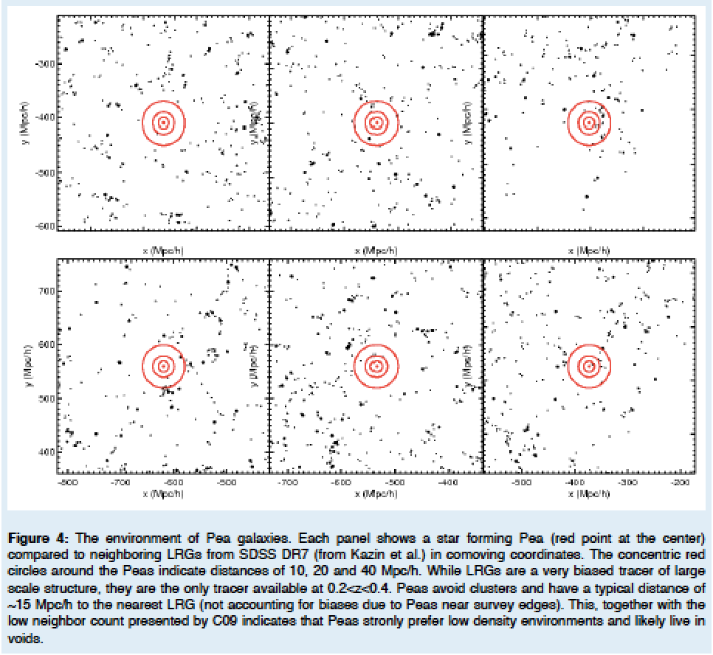
Kevin’s HST SNAP proposal / ~15 Mpc/h to nearest DR7 LRGs
Notes:
(10,20 & 40 Mpc/h) – red circles
Strongly prefer low density environments. . . .

Slide 12
Mapping Environment of Green Peas
Original idea – match peas to a Mock Universe
Looking at abundance matching
e.g., distance to 5th nearest neighbor (W/in Mstar)
e.g., distribution of Neighbors within 1/5 Mpc

Slide 13
Searching for Pea Neighbors
Starting with the original sample of 80 peas, looking within 50 Mpc projected
Neighbors found with specz 427
Neighbors in photometric catalog 120595
Neighbors found with photo redshift est 20743
Neighbors found w/ photoz in 1sig of pea z 9844
+ -> photo error class 1 3560
*** only a handful (35) remain if looking within 5 Mpc… ***

Slide 14
To Dos:
Compute 3D distance between a pea & a neighbor using redshifts (lumdist.pro)
Find a selection sample for 5th nearest neighbor . . .
Finalize DR12 selection of peas for follow-ups (still cleaning), figure out how to avoid galaxies!
Start learning compute.sciserver.org (Read in a catalog from casjobs)

Slide 15
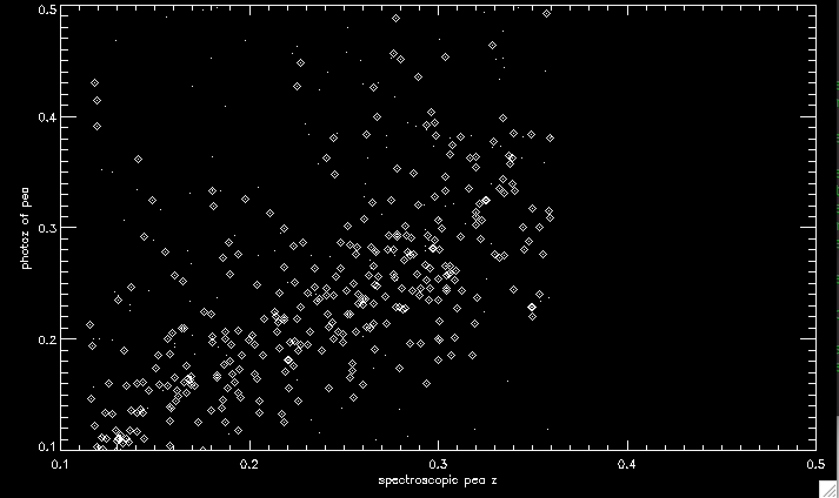
Photo-z catalog compared to spec for the DR12 Peas

Slide 16
Search for Peas in DR12
Original Sample was 251 in color, 80 SF spectra (9 stripe 82)
DR12 search 4155 in color / size / EW OIII
Portsmouth Gandalf fits: 2203
Star Forming BPT 1469 - 1346 w/ clean phot
(45 in Stripe 82)
Note this recovers 57 of the 80 original

Slide 17
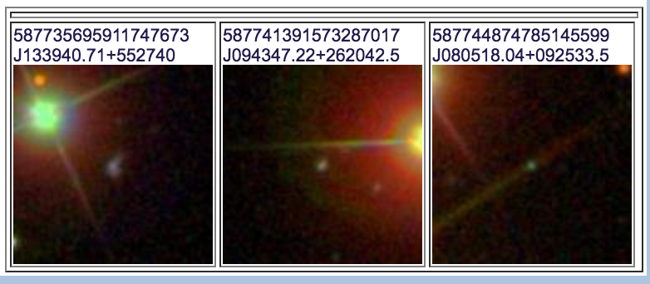
8 from Original 80 not recovered
3 BAD photometry – near bright objects….
2 not in Portsmouth Catalog
3 had EW < 0.5
15 Not classified as ‘Star Forming’ in BPT
(Seyfert, Composite, LINER)

Slide 18
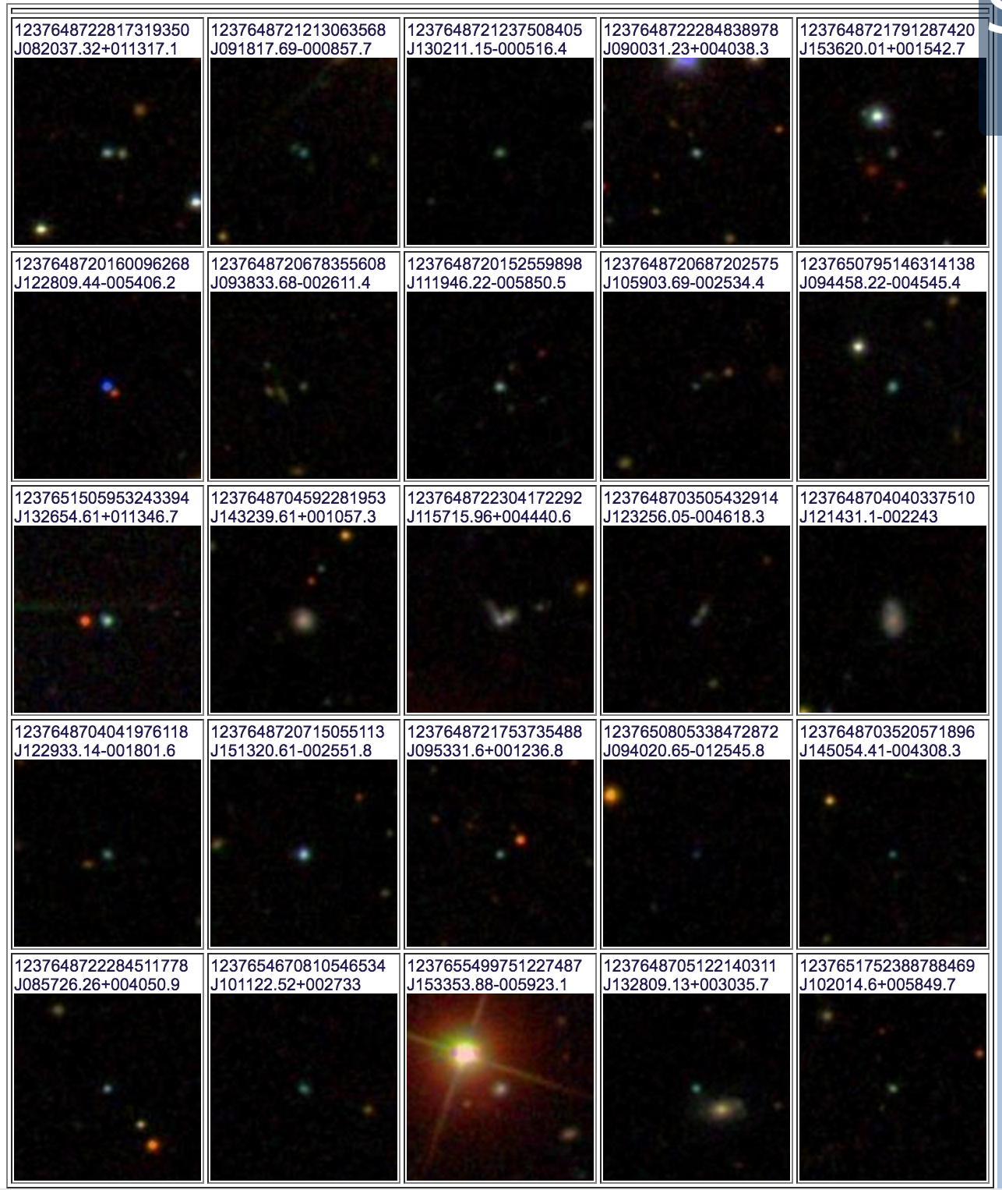
Images of DR 12 Peas Stripe 82

Slide 19
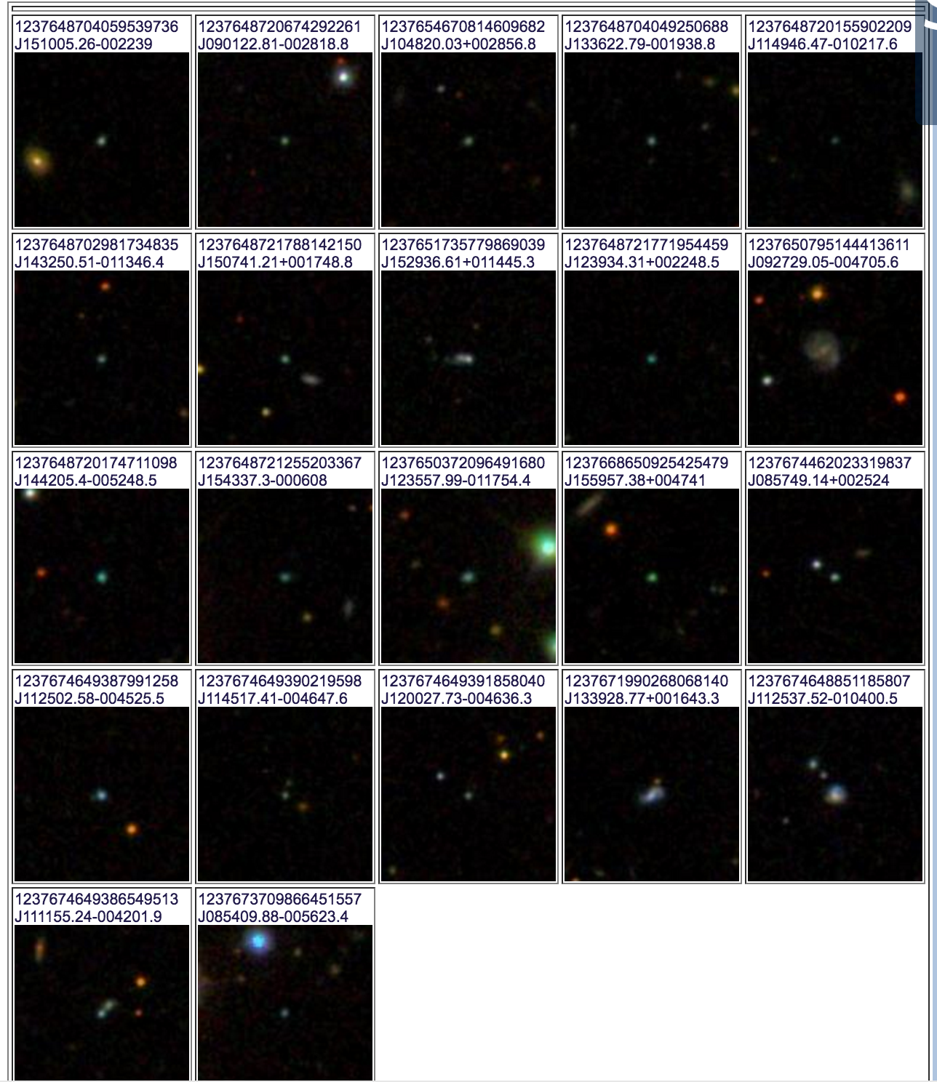
Images of peas Stripe 82

Slide 20
